Slide 1

Microsoft Entra Permissions Management
Introduction

Slide 2
Agenda
What is a CIEM?
Securing Cloud Infrastructure
What are the challenges Microsoft Entra Permissions Management can help me overcome?
Why should you care?
Next steps and Proof of Concept

Slide 3









Microsoft Entra Product Family
Identity & access management
New Identity categories
Network Access
Microsoft Entra ID
Microsoft Entra Internet Access
Microsoft Entra Verified ID
Microsoft Entra ID Governance
Microsoft Entra Permissions Management
Microsoft Entra Private Access
Microsoft Entra External ID
Microsoft Entra Workload ID

Slide 4
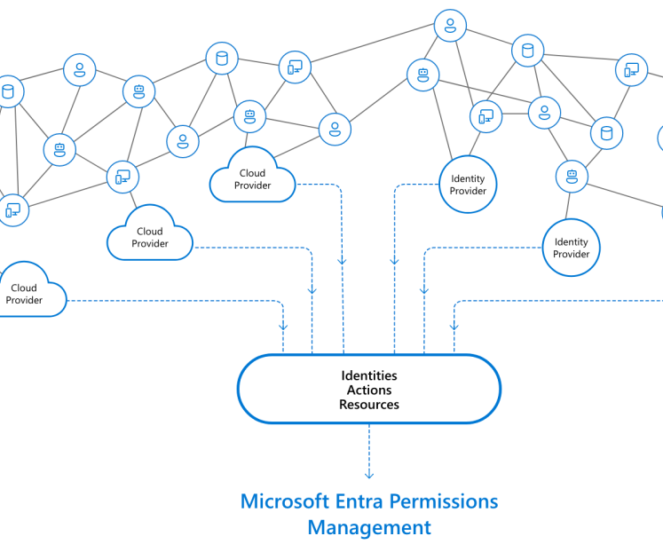
What is a CIEM?

Slide 5
What is a CIEM?
CIEM: Cloud Infrastructure Entitlement Management
How does it help organizations
Analytics
Enforcement
Risk
CIEM tools help organizations manage
cloud access risks via administration-time controls for the governance of entitlements in hybrid and multicloud infrastructure as a service (IaaS).
They use analytics, machine
learning (ML) and other methods to detect anomalies in account entitlements, like accumulation of privileges and dormant and unnecessary permissions.
CIEM ideally provides enforcement and remediation of least-privilege approaches. Some CIEM tools can extend entitlement controls to SaaS applications and identity providers (IdPs) like Microsoft Azure Active Directory, and also provide basic threat discovery, incident response and forensics.

Slide 6
What is a CIEM?
“The challenge of managing privileges in IaaS is worsening, with thousands of services added in recent years by cloud providers. Security and risk management leaders must combine traditional IAM approaches with CIEM to achieve efficient identity-first security management results.”
- Gartner
Cloud infrastructure entitlement management (CIEM) offerings are:
Specialized identity-centric SaaS solutions focused on managing cloud access risk via administration-time controls for the governance of entitlements in hybrid and multicloud IaaS.
Typically use analytics, machine learning (ML) and other methods to detect anomalies in account entitlements, like accumulation of privileges, dormant and unnecessary entitlements.
CIEM ideally provides remediation and enforcement of least privilege approaches.
- Gartner

Slide 7







VMs
Containers
CMPs
IaC
How did we get here?
A brief history of cloud security technologies
CWPP
CSPM
Serverless
CIEM
CNAPP
2010
2014
2018
2020
Cloud Native Application Protection Platforms
Provides a holistic view of cloud security risks by scanning workloads and configurations in development and protecting them at runtime. Secures applications by identifying, assessing, prioritizing, and adapting to risk in cloud-native applications, infrastructures, and configurations.
CNAPP
Cloud Infrastructure Entitlement Management
Manages identities and access privileges in multi-cloud environments, applying the principle of least privilege access to cloud infrastructure and services while identifying anomalies in account entitlements.
APPLICATION
CLOUD
Cloud Workload Protection Platform
Endpoint protection solutions tailored to server workloads wherever they are running today (VMs, public cloud IaaS, PaaS, etc.).
CIEM
CWPP
IAM
Microsoft Entra Permissions Management
DevOps Workflow
Microsoft Defender for Cloud
CSPM
Cloud Security Posture Management
Leverages native API integrations with IaaS cloud service providers to discover and assess risks of cloud assets and configuration.
Cloud Behavior
Microsoft Defender for Cloud

Slide 8
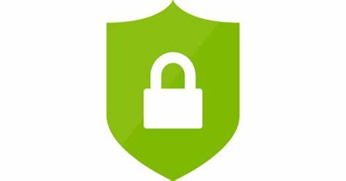
Securing Cloud Infrastructure

Slide 9


Confusion…?
Lots of cloud security products, all doing related, but different things
SASE, CASB, CIEM, SIEM, CNAPP, the list goes on
Microsoft has several of these offerings:
Entra Permissions Management
Defender for Cloud
Defender for Cloud Apps
Sentinel
Etc.
What should you be using, and for what purpose?

Slide 10



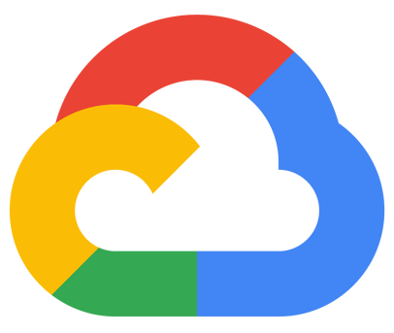

Securing Cloud Infrastructure
Big Picture of Products and Capabilities
Patch level
Ports
Hardening
& more
Microsoft Defender for Cloud (CSPM)
Microsoft Defender for Endpoint (through MDC) (CWPP)
Malicious execution patterns
Anomalous processes
& more
Identity
Provider
Identity
Provider
Identities
Actions
Resources
Microsoft Entra Permissions
Management (CIEM)
Over-privileged identities
Irregular permission pattens
Unused permissions
& more

Slide 11


Securing Cloud Infrastructure
Two complementary products
Defender for Cloud
Microsoft Entra Permissions Management
Cloud security posture management for protecting workloads running in the cloud
Examples:
Ensure monitoring agents are installed on VMs
VM disks should be encrypted
Network Security Groups should restrict most ports
Endpoint protection software should be installed on VMs
Evaluate permissions for the cloud control plane
Examples:
Azure admins that manage storage accounts should only have the Storage Administrator role, not Subscription Contributor
Storage accounts should not allow anonymous access
Developers should not have standing access to AWS VMs

Slide 12
What are the challenges Permissions Management can help you overcome?

Slide 13


(Multi-)cloud adoption brings new permission challenges
Exponential growth of identities, machines, functions, and scripts operating in the cloud infrastructure
>90% of identities are using <5% of permissions granted
>50% of permissions are high-risk and can cause catastrophic damage

Slide 14

Unmanaged permissions are expanding the attack surface
Lack of comprehensive visibility into identities, permissions and resources
Increased complexity for IAM and security teams to manage permissions across multicloud environments
Permissions Gap
Permissions
Permissions Granted
Increased risk of breach from accidental or malicious permission mis-use
Permissions Used
Time

Slide 15
Managing permissions across multicloud environments requires a new approach
Today’s static, outdated approach
A new, dynamic approach
Grants permissions based on job roles and responsibilities
Grants permissions based on historical usage and activity
Grants permissions based on job roles and responsibilities
IAM admins manually grant permissions which are not time-bound
Allow temporary access to high-risk permissions on-demand
IAM admins manually grant permissions which are not time-bound
Permission clean-up is done manually on an as-need basis
Continuously monitor and right-size identities to prevent privilege creep
Permission clean-up is done manually on an as-need basis

Slide 16
What are the common challenges?
Permissions granted based on broad job roles and responsibilities
Common to grant broadest permissions that could ever be needed by a role or team
Not based on what tasks each person will actually perform
IAM admins manually grant permissions which are not time-bound
Permission requirements change over time – not enough admins in the world to keep up with the pace of change in most enterprises. Users will naturally accrue more and incorrect permissions as time goes on
Compromised account can be used to wreak havoc, especially if attacker can phish an MFA credential
Permission clean-up is done manually on an as-needed basis
Access review processes are manual, time-consuming, and usually all or nothing
Hard to gain deep enough insights into actual usage to do real least privilege right-sizing
Hard to operationalize if processes are too manual – permission right-sizing not performed frequently enough

Slide 17


Use case: Cloud Infrastructure Operations Team
Monitor access to infrastructure resources containing sensitive data
Monitor and manage permissions of identities and resources across multicloud environments
Detect, assess, alert and remediate anomalies and outliers across the three dimensions of identity, resource and action

Slide 18

Use case: Security Team
Monitor, assess and alert excessive permissions for human and workload identities including machines, serverless functions, access keys, bots, etc.
Monitor access to infrastructure resources containing sensitive data
Detect and respond to security anomalies
Automate assessment, remediation, and monitoring

Slide 19

Use case: Identity and Access Management Team
Implement least privilege policies for human and workload identities by right-sizing permissions based on usage
Handle authorization and reviews for access requests
Manage access recertification campaigns
Manage access lifecycle for all identities

Slide 20
Business Benefits and ROI

Slide 21
What does your business get out of EPM?
Alignment with your Zero Trust journey
ZT Principles: Verify Explicitly, Use Least-Privilege Access, Assume Breach
These principles sound good, but are hard to live by without the right tooling and automation
More than just neat technology, you get concrete ROI:
Reduced blast radius when accounts are compromised
Automated right-sizing of roles reduces manual remediation work
Monitor and alert on cloud-native asset types, such as machine identities and serverless functions
Reporting to the business
Are you reducing your risk over time?
What is your overall risk across all Cloud Solution Providers?
Are you able to provide evidence for auditors of just enough access?

Slide 22
NIST Zero Trust Goal and Principles (NIST SP.800-207)
Goal:
Protect data, computing services (infrastructure), and business functions by “eliminating unauthorized access, coupled with making the access control enforcement as granular as possible.”
Principles:
Network is hostile
Continued risk analysis and evaluation (never trust and always verify)
Enact protections to mitigate risk
- Minimize access to resources to only those who are validated as needing access
- Continuously authenticating the identity and security posture of each access request
- Access is granted through a Policy Decision Point (PDP) and Policy Enforcement Point (PEP)
Ref: Zero Trust Architecture (nist.gov)

Slide 23
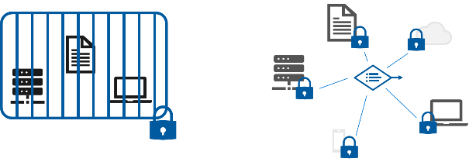
Business Benefits of Zero Trust
Line of Business
Business Support (Finance, HR, etc.)
IT & Security
Business Agility – for continuous business environment changes:
Business Models and Partnerships
Technology Trends
Regulatory, Geopolitical, Cultural Forces
Disruptive Events
Paradigm Shift to Remote Work
Accelerate digital transformation initiatives and lower risk
Accelerate process modernization using cloud technologies
Rapidly apply policy as people change roles
Employee ←→ supplier ←→ partners
Better business risk visibility & mitigation for acquisitions and new ventures
Simpler architectures are more cost effective, easier to support, and reduce the threat surface
Less policy exceptions and escalations to manage
Better visibility into technical risks
Better prevention of common security risks

Slide 24
Business Benefits of Entra Permissions Management
ZT Benefits EPM contributes to
Line of Business
Business Support (Finance, HR, etc.)
IT & Security
Business Agility – for continuous business environment changes:
Business Models and Partnerships
Technology Trends
Regulatory, Geopolitical, Cultural Forces
Disruptive Events
Paradigm Shift to Remote Work
Accelerate digital transformation initiatives and lower risk
Accelerate process modernization using cloud technologies
Rapidly apply policy as people change roles
Employee ←→ supplier ←→ partners
Better business risk visibility & mitigation for acquisitions and new ventures
Simpler architectures are more cost effective, easier to support, and reduce the threat surface
Less policy exceptions and escalations to manage
Better visibility into technical risks
Better prevention of common security risks

Slide 25
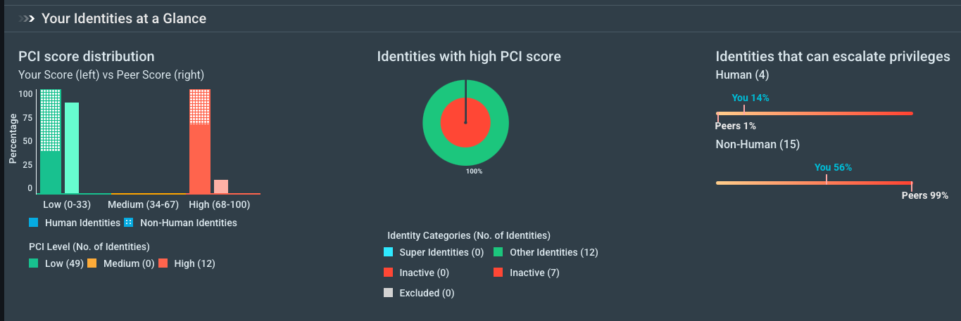
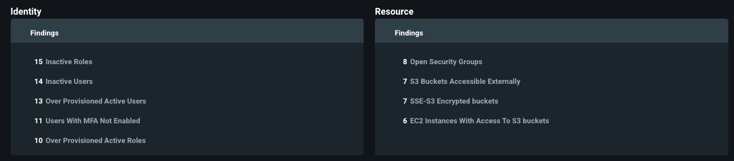
Reporting on Overall Security to the Business
Glanceable and scheduled reports that can provide business leaders insight into risk and improvement over time
Identity and Resource centric views of risk

Slide 26
Reporting on Overall Security to the Business
What do executives care about when it comes to cloud security?
How does EPM Address this concern?
Reduce permissions to only what’s needed
Overall Risk Exposure
Decrease blast radius of an incident through reduction of permissions
Cost per incident
Permissions Creep Index historical report, other reports
Improvement over time

Slide 27

Next Steps and POC

Slide 28
Where do we go from here?
Continue the workshop, of course…
Onboard some production Azure Subscriptions, AWS Accounts, and/or GCP Projects into Entra Permissions Management with read-only permissions
Investigate initial “quick win” findings discovered in POC
Understand automation and alerting capabilities
Turn on automation for test resources?
Purchase? – Talk to us and your account team if you want to keep going
Deploy what you own
Transition from read-only mode to report only and manage mode, use automation and alerting
Use permissions on demand
Enhance – integrate with your SOC, SIEM, and ServiceNow
Provide product feedback

Slide 29
Workshop FAQ
What's the intended outcome?
For you to go from 0 to deployed with EPM, understand the value it brings to your organization, and to have a clear plan on what to "go do" moving forward
How long will this POC be?
We'll go through the workshop content in a couple of hours
What will Microsoft own vs what will you own?
We'll offer deployment guidance and best practices we've seen other customers leverage. You will need to operate EPM. If you'd like deeper assistance, we can connect you with a partner for more hands-on guidance
What does success look like?
That you're up and running with EPM, understand what it can do, and have a path forward on what to do next
Any other questions before we continue?

Slide 30

Thank you!

